Slide 1


MS Excel

Slide 2
Contents
Introduction
Interface & Tools 3. Formatting
Formula & Calculations
SUM, AVERAGE, MAX, MIN
Percentage formula
IF Condition
Sorting
Filter
Charts

Slide 3
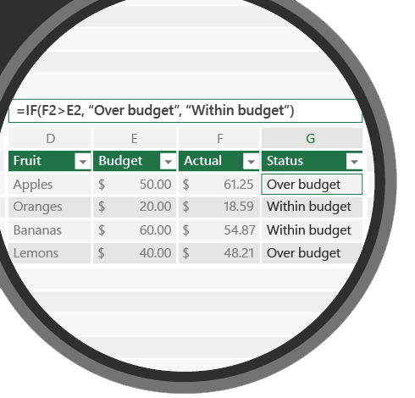

SORTING
5
Ascending & Descending order
Syntax
Ascending & Descending | A-Z & Z-A

Slide 4
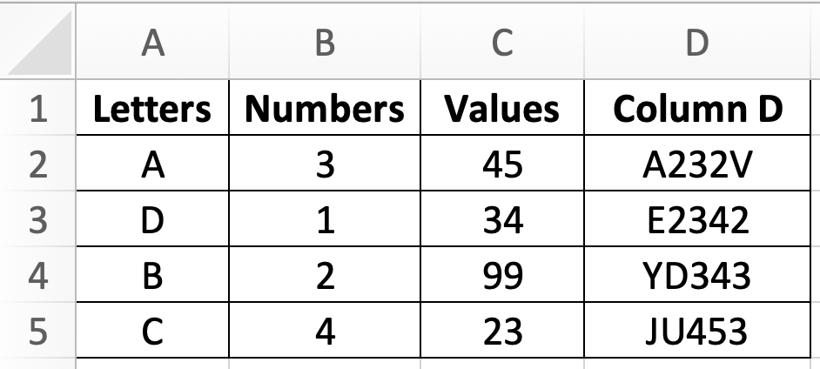
5.1
Sort
Ascending & Descending

Slide 5
5.1 Question
Sort below table into descending order according to Letters
Sort below table into ascending order according to Values
Sort below table into ascending order according to Column D

Slide 6
5.1 Question
Q1. Ascending order means
Smallest to largest
Largest to smallest
Q2. Descending order means
Z to A
A to Z
Q3. Most preferred way of sorting
Sort original table
Sort the copied table
Both wrong

Slide 7
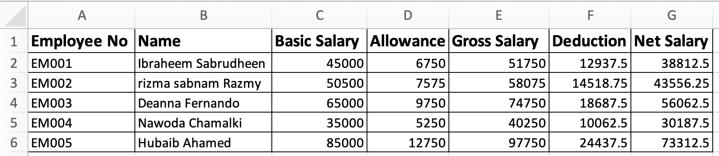
5.2
Sort
Ascending & Descending

Slide 8
5.2 Question
Sort below table Employee No into ascending order
Sort below table Net Salary into descending order
Sort below table Allowance into ascending

Slide 9
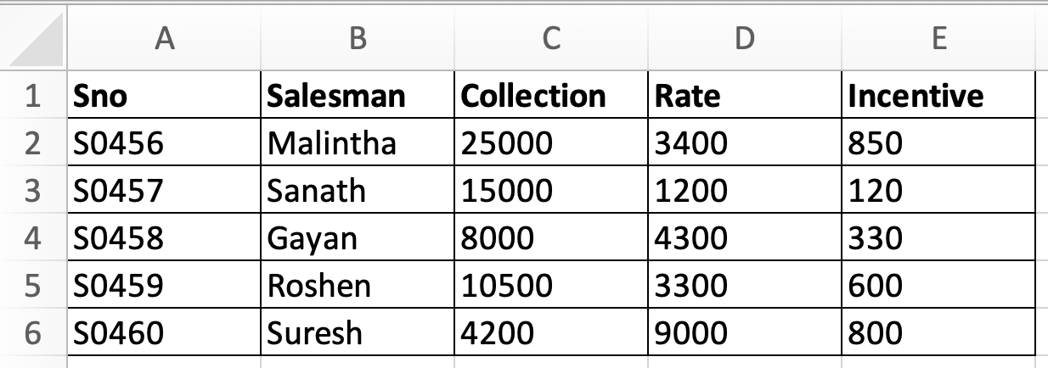
5.3
Sort
Ascending & Descending

Slide 10
5.3 Question
Sort below table Salesman into ascending
Sort below table Rate into descending
Sort below table Sno into ascending

Slide 11
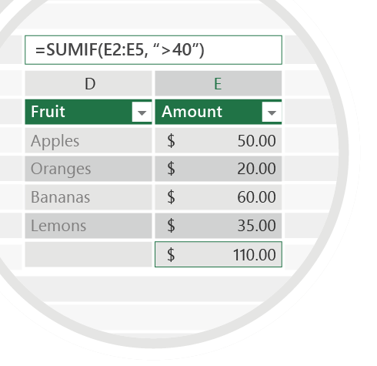



Exercise 5
Check your email for Question 5.1.pdf Question 5.2.pdf Question 5.3.pdf
Sort attached table according to given instructions
Emails
TO : shalomshan089@gmail.com

